Slide 1
Delta Modulation
Delta modulation is a technique used to convert analog-to-digital and digital-to-analog signal.
In this modulation,signal is sent in differential form,the data is encrypted/transmitted in 1 bit.
The analog signal is approximated with series of segments and each segment is compared to original analog to determine the change in relative amplitude.
Hence only change in information is sent and if no change occurs it remains on the same state.
This is the simplified form of Differential Pulse code Modulation and also called as 1-bit(2-level) version of DPCM.
It provides a staircase approximation of over-sampled base-band signal. Here, the difference between the present sample and previous approximated sample is quantized into two levels i.e. ± Δ (delta).
This is used for voice transmission.

Slide 2
Operating Principle :
The operating principle of DM is such that, a comparison between present and previously sampled value is performed, the difference of which decides the increment or decrement in the transmitted values.
when the two sample values are compared, either we get difference having a positive polarity or negative polarity.
If the difference polarity is positive, then the step of the signal denoted by Δ is increased by 1. As against in case when difference polarity is negative then step of the signal is decreased i.e., reduction in Δ.
When +Δ is noticed i.e., increase in step size, then 1 is transmitted. However, in the case of –Δ i.e., decrease in step size, 0 is transmitted

Slide 3
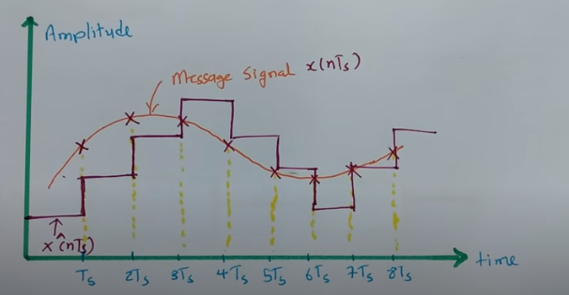

Slide 4
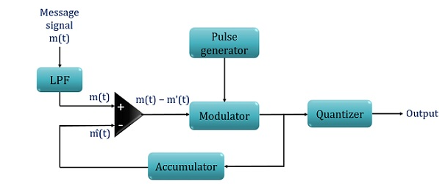
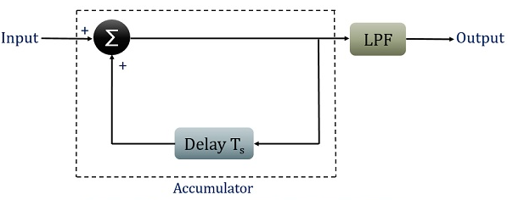
Generation and detection of DM Signal : fig- DM transmitter fig-DM reciever

Slide 5
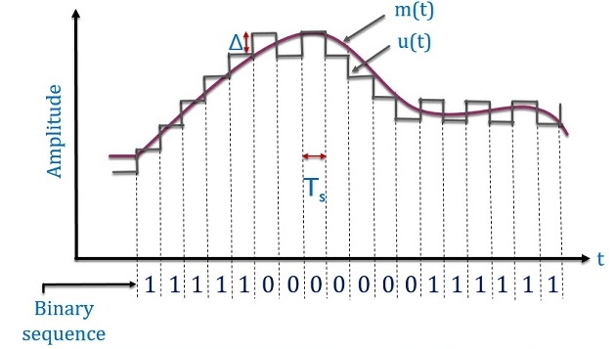
Waveform representation of Delta Modulated Signal:

Slide 6
Advantages of delta modulation Due to transmission of 1 bit per sample, it permits low channel bandwidth as well as signaling rate. ADC is not required. Thus permits easy generation and detection. Disadvantages of delta modulation Delta modulation leads to drawbacks such as slope overload distortion(when Δ is small)and granular noise(when Δ is large). Applications of delta modulation It is widely used in radio communication devices and digital voice storage and voice transmission.

Slide 7
Matlab code:
% plots
figure
plot(t,x);
xlabel('time');
title('original signal');
figure
stairs(t,10*codebook(encodedx+1),'g');
xlabel('time');
title('DM output');
figure
plot(t,x);
hold;
stairs(t,decodedx);
grid;
xlabel('time');
title('received signal');
%% Delta Modulation (DM)
predictor = [0 1];
partition = [-1:.1:.9];
step=0.2;
partition = [0];
codebook = [-1*step step];
%DM quantizer
t = [0:pi/20:2*pi];
x = 1.1*sin(2*pi*0.1*t); % Analog Signal
% Quantize x(t) using DPCM.
encoded_x=dpcmenco(x,codebook,partition,predictor);
% Try to recover x from the modulated signal.
decoded_x=dpcmdeco(encoded_x,codebook,predictor);

Slide 8
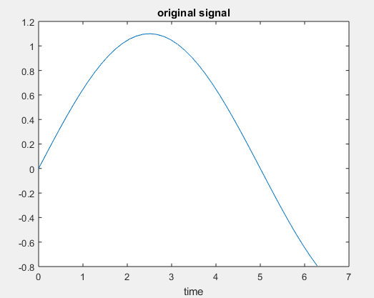
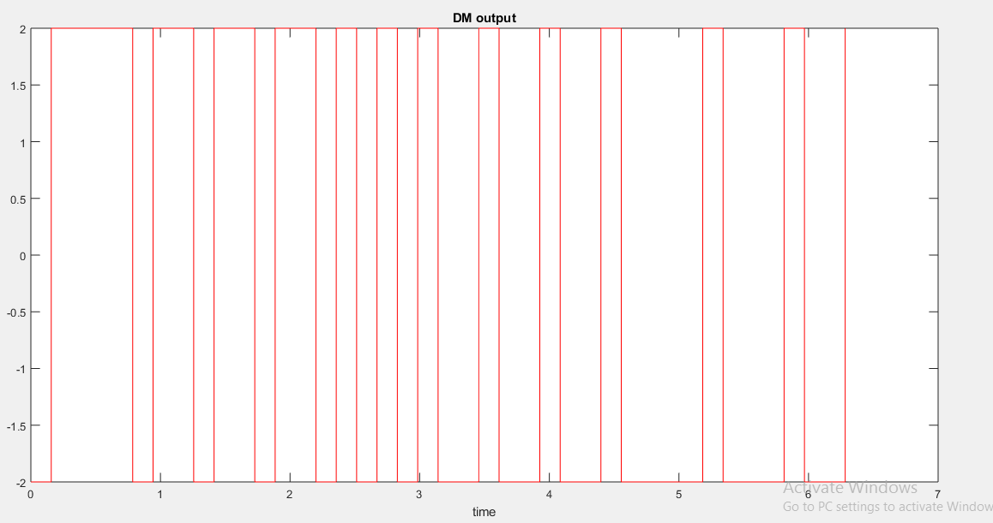
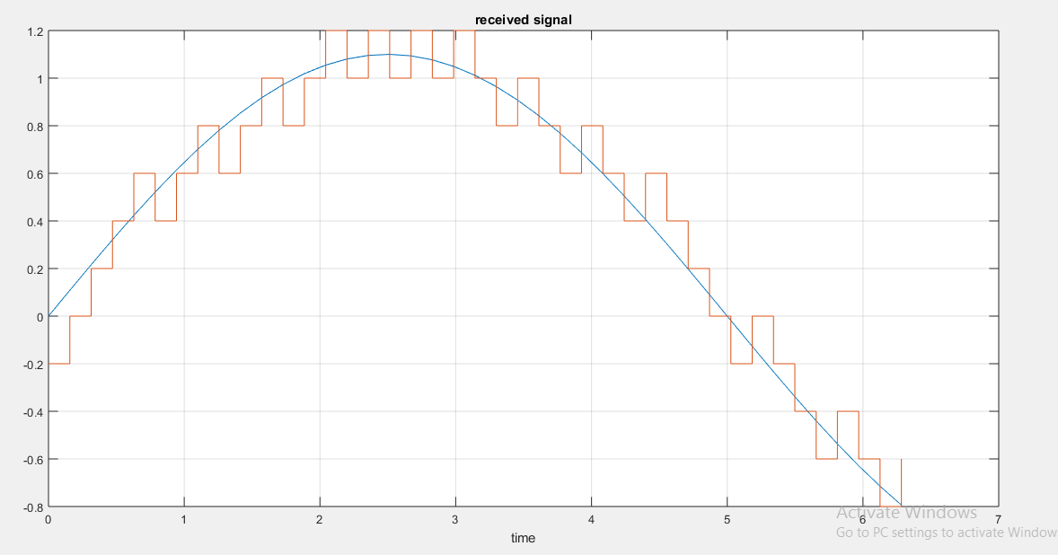

Slide 9
THANK YOU

